Slide 2
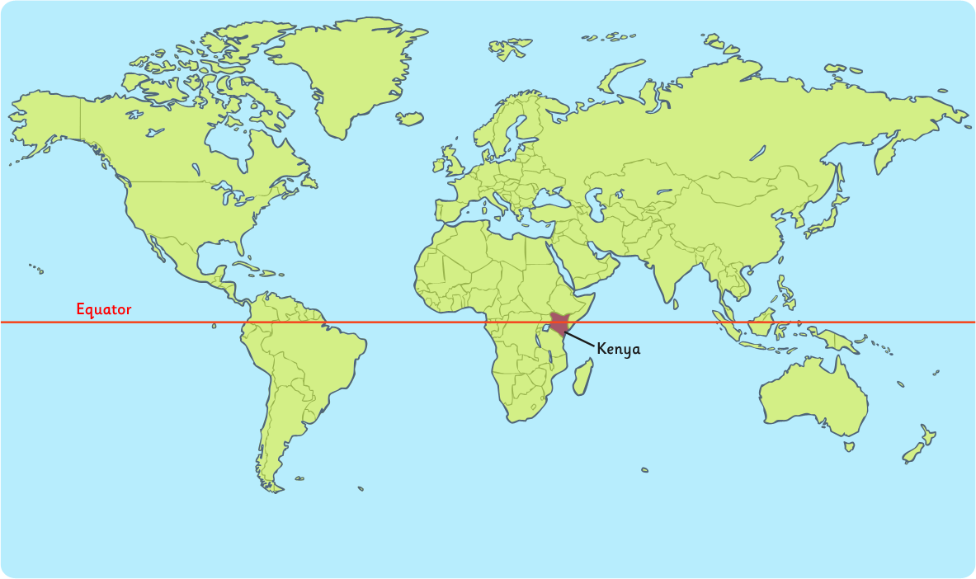
Kenya is located in East Africa,
which lies on the Equator

Slide 3
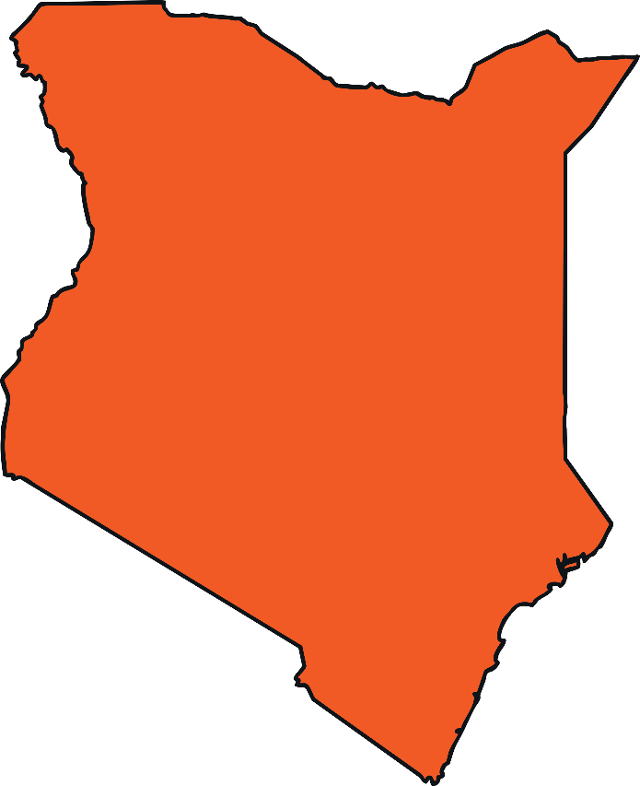
The population of Kenya is
47.5 million.
(2019 Census)

Slide 4
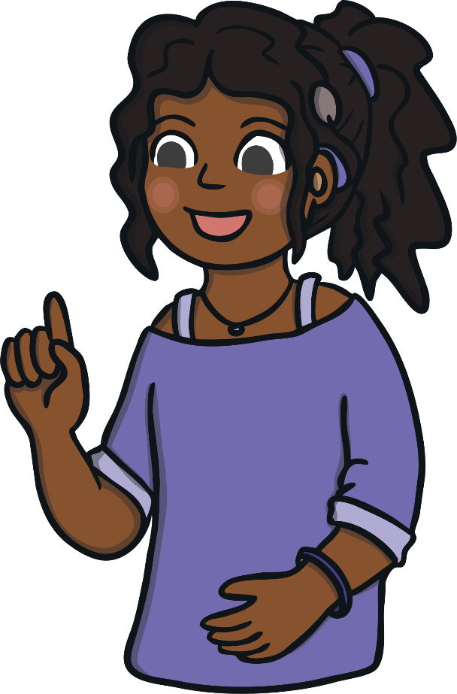
The two official languages in Kenya are English and Swahili, although there are around 60 languages spoken in different parts of the country.
Almost everyone in Kenya
speaks more than one
African language!

Slide 5
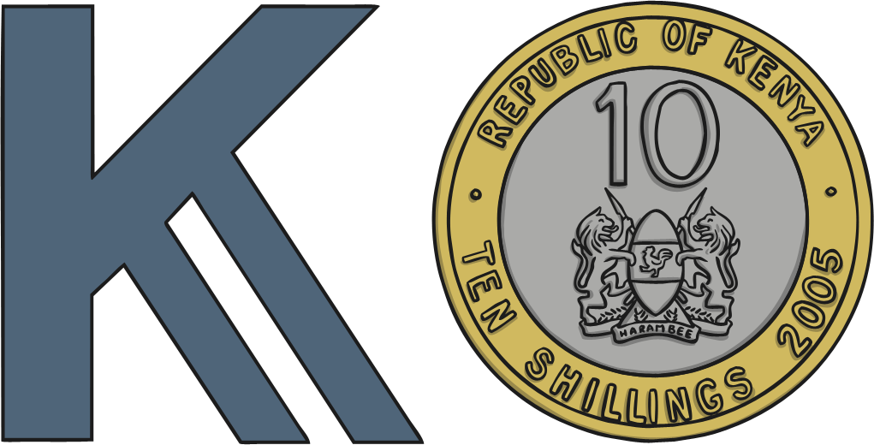
The currency is the Kenyan Shilling.

Slide 6
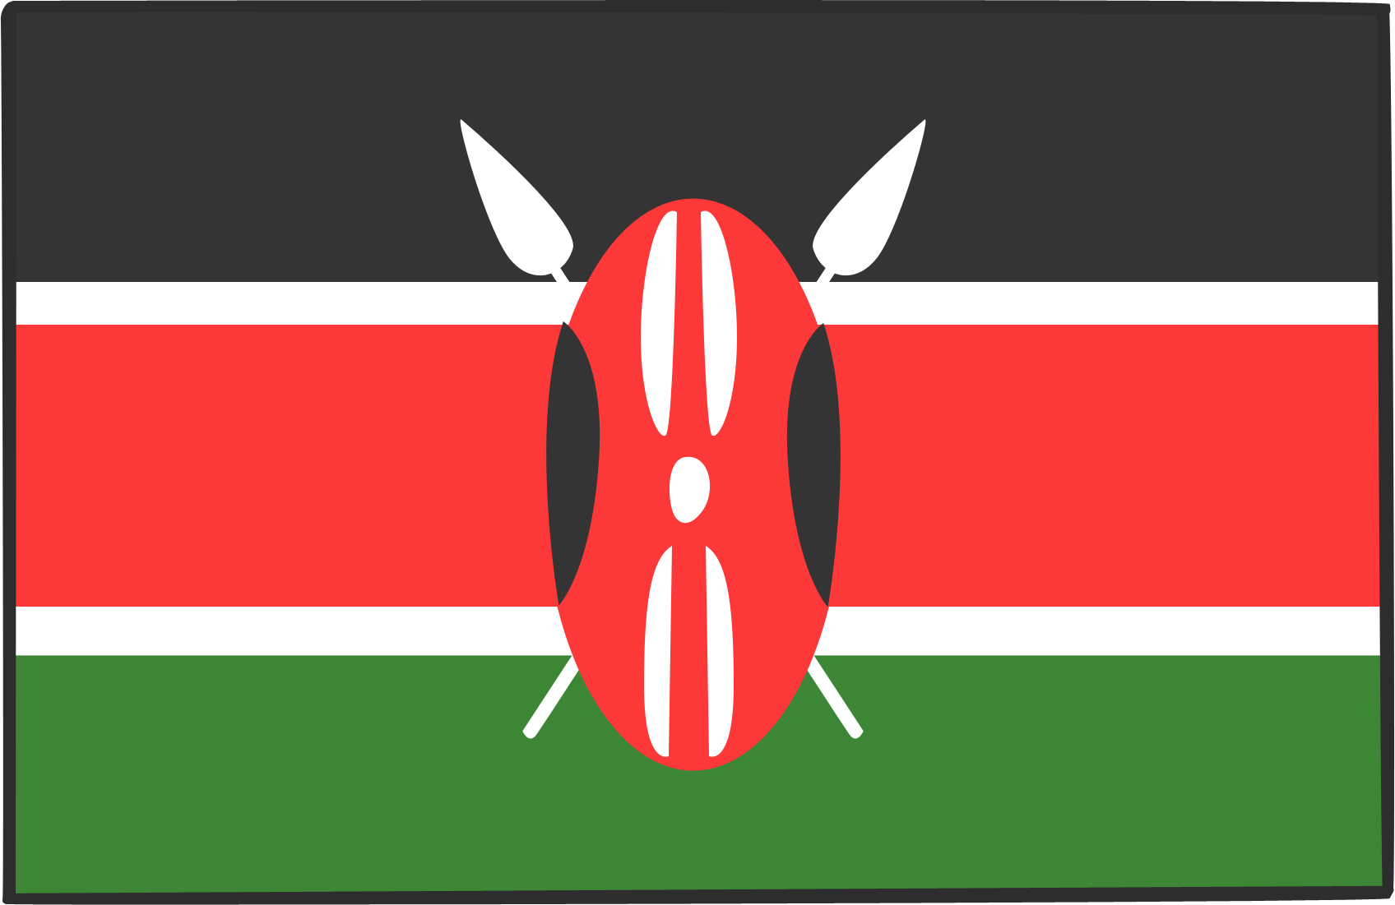
This is Kenya’s flag:
Kenya is officially called the Republic of Kenya.

Slide 7
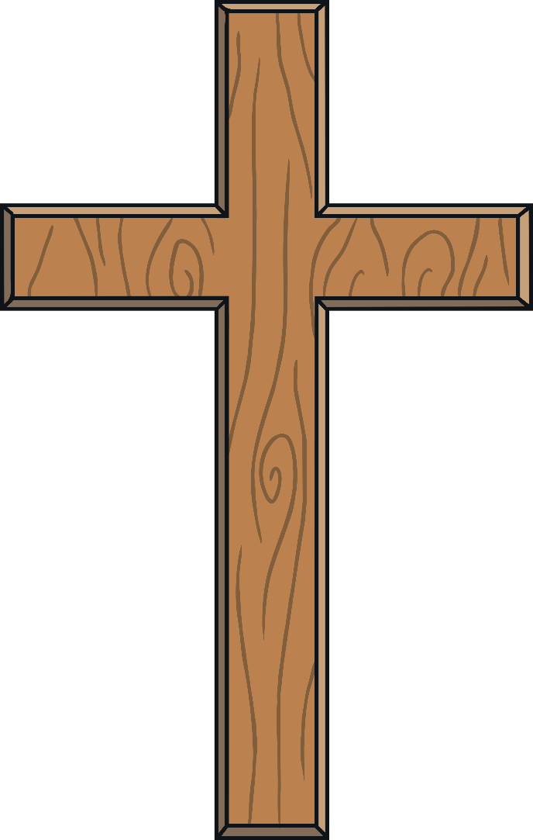
More than 8 out of 10 Kenyans are Christian.
Islam is the second largest religion (about 1 in 10 people).
The other religions of Kenyans are Baha’i, Buddhism, Hinduism and traditional African beliefs.

Slide 8
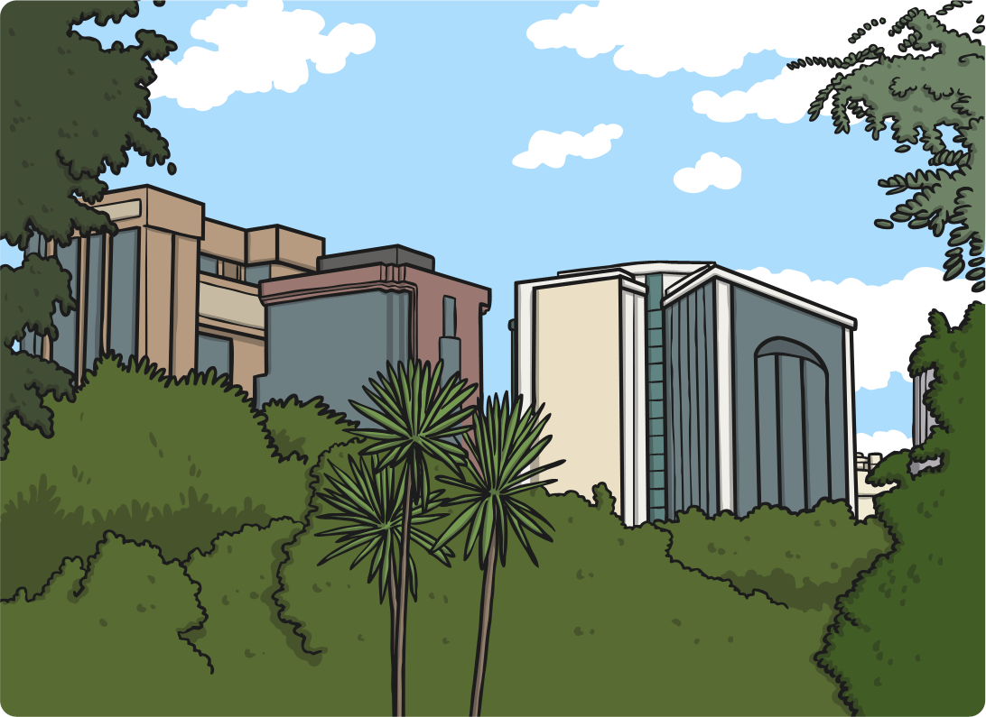
The capital of Kenya is Nairobi.

Slide 9
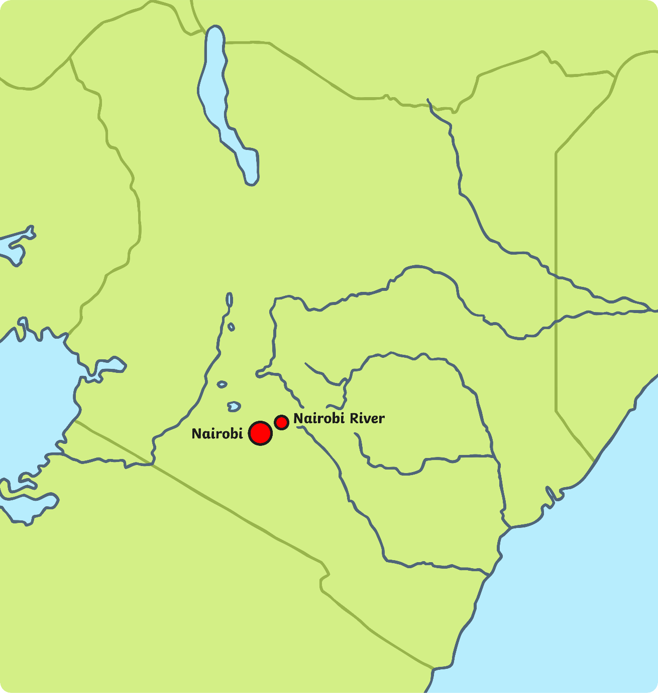
Nairobi is the biggest city in Kenya.
Its name means ‘cool water’ in the Maasai language. The Nairobi River flows through the city.

Slide 10
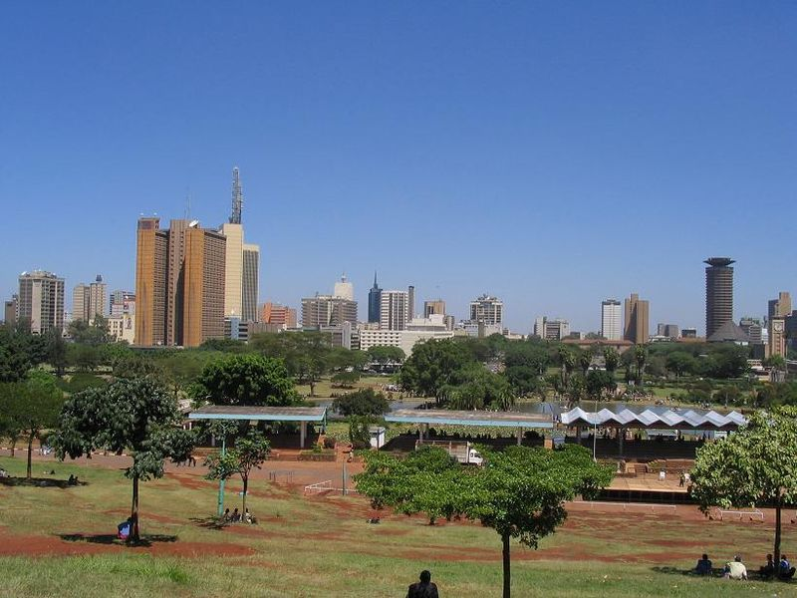
The sunniest time of year is from December to March. The coolest months are June and July. There are only two seasons (wet and dry) because Nairobi is so near the equator.

Slide 11
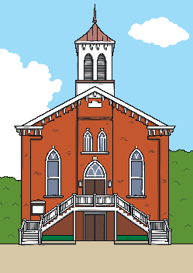
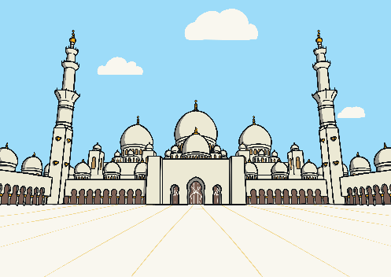
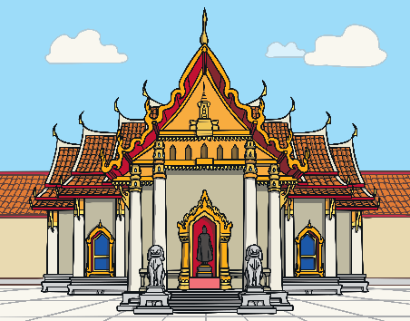
The people who live in Nairobi come from many different cultures.
There are many churches, mosques, temples
and gurdwaras in the city.
It is one of Africa’s most modern cities. There are thousands of businesses and companies in Nairobi. Also, many tourists visit every year.

Slide 12
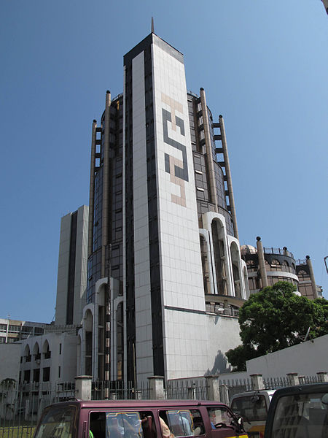
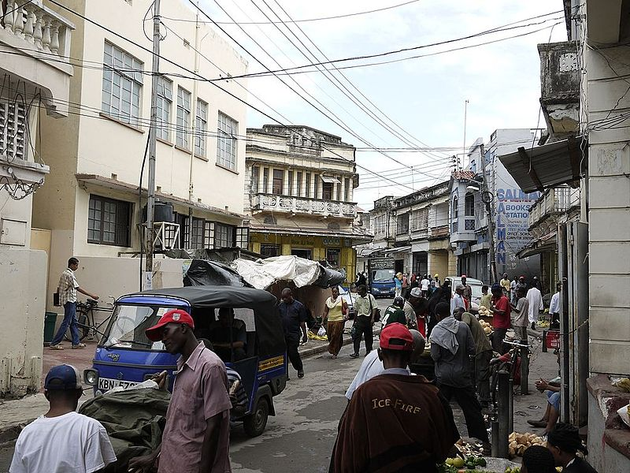
The second biggest city in Kenya is Mombasa.
It is a seaport city that was first built around
the year 900 AD.
“Mombasa Building” by [Stefan Magdalinski] is licensed under CC BY 2.0
“Mombasa-Schmilblick” by [schmilblick] is licensed under CC BY 2.0

Slide 13
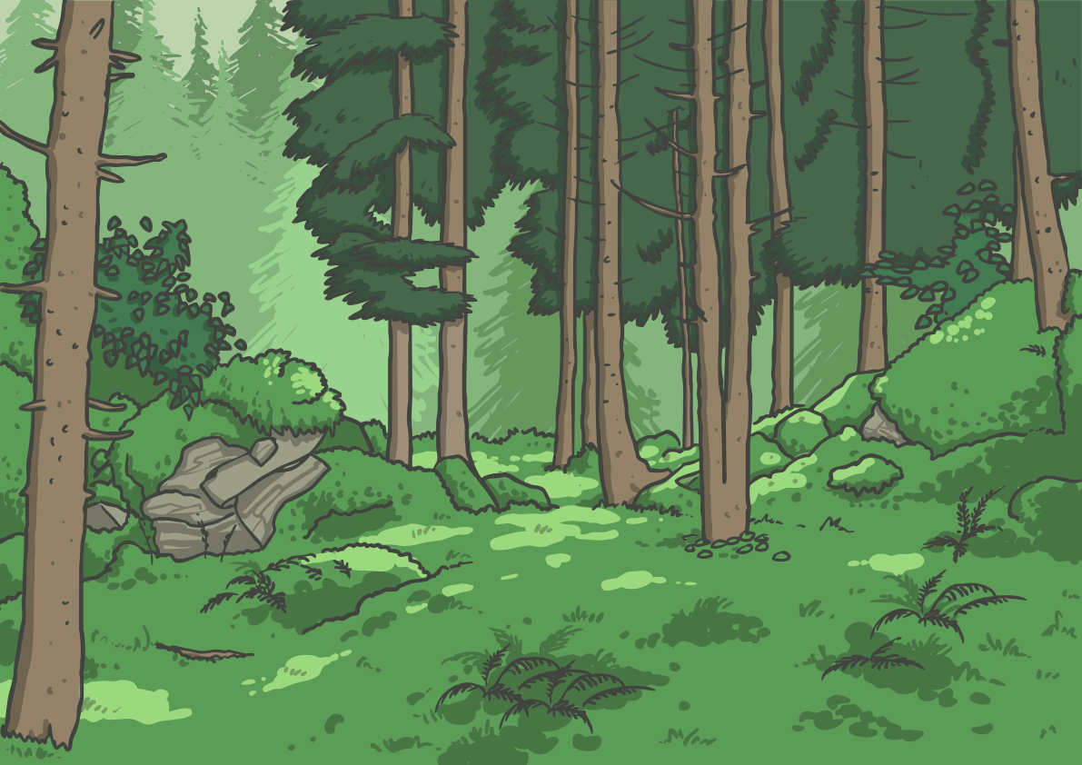
Kenya is famous for its savannah habitat but it also has many different landscapes, such as deserts, swamps, mountains and forests.

Slide 14
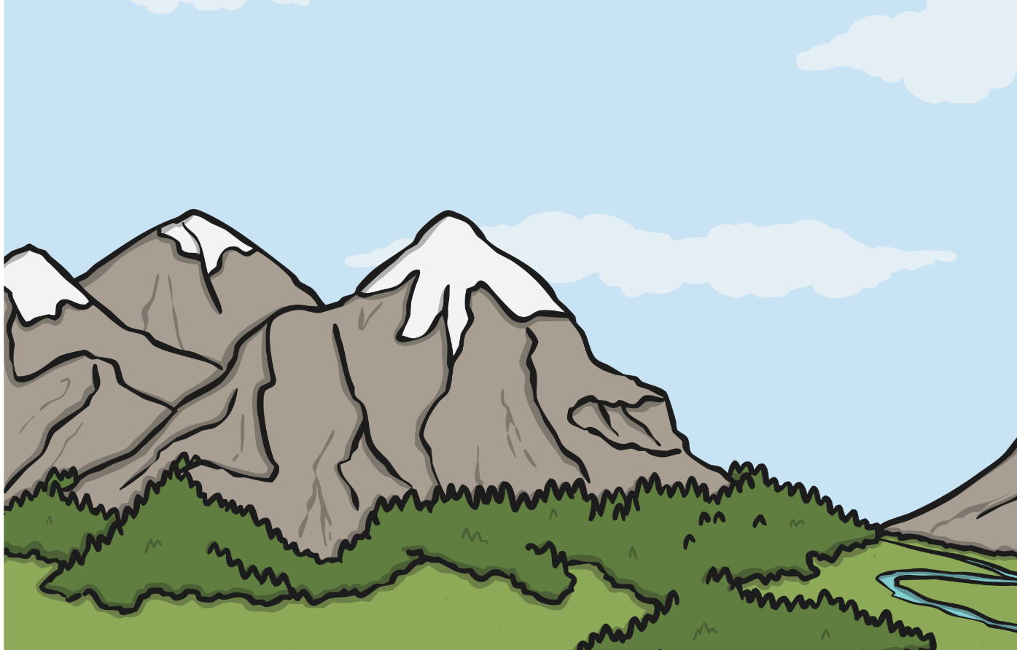
Mount Kenya is the highest mountain in Kenya at 5199m high! Most Kenyans live in the highlands. Nairobi is 1700m above sea level.

Slide 15
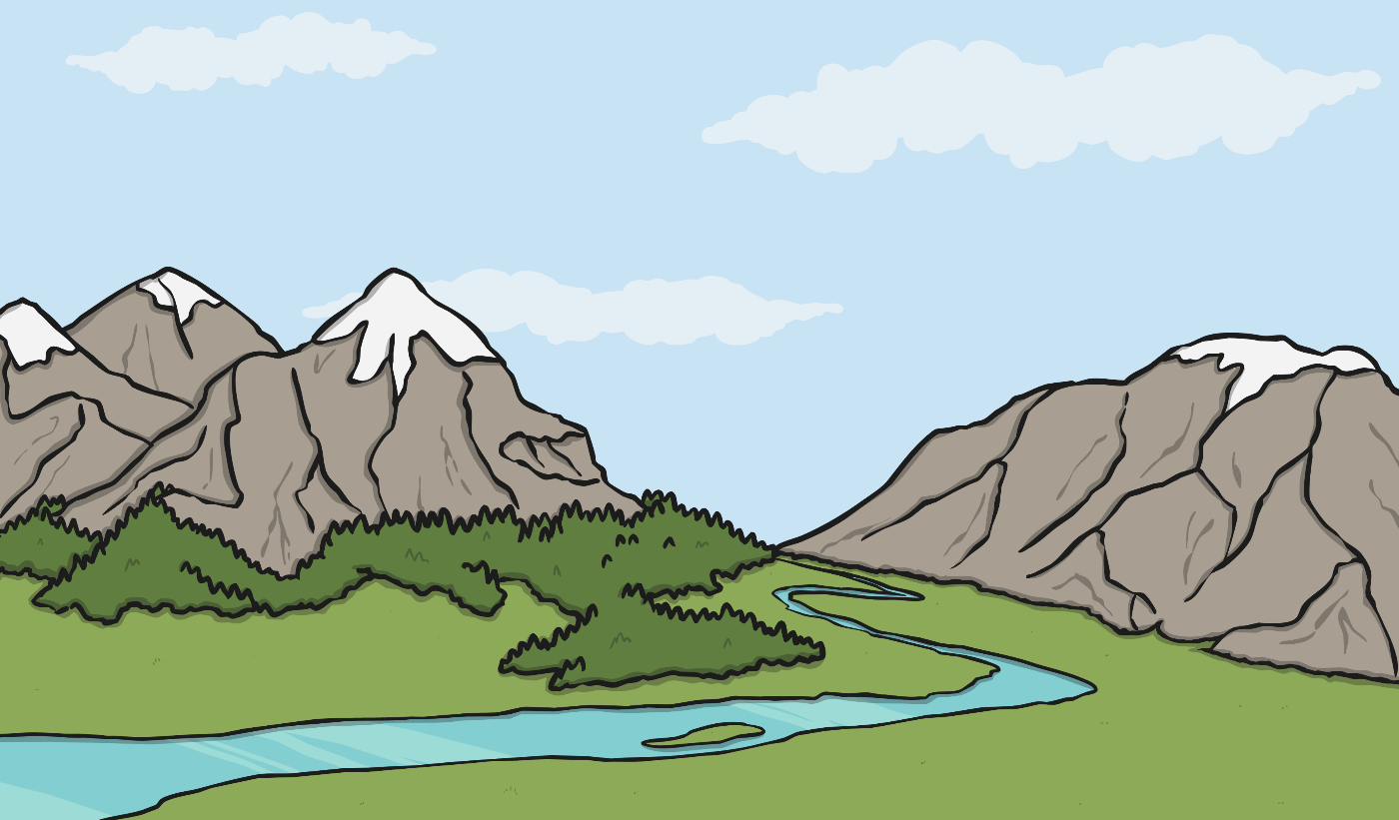
Kenya’s longest river is the Tana,
which runs for 1000km!

Slide 16
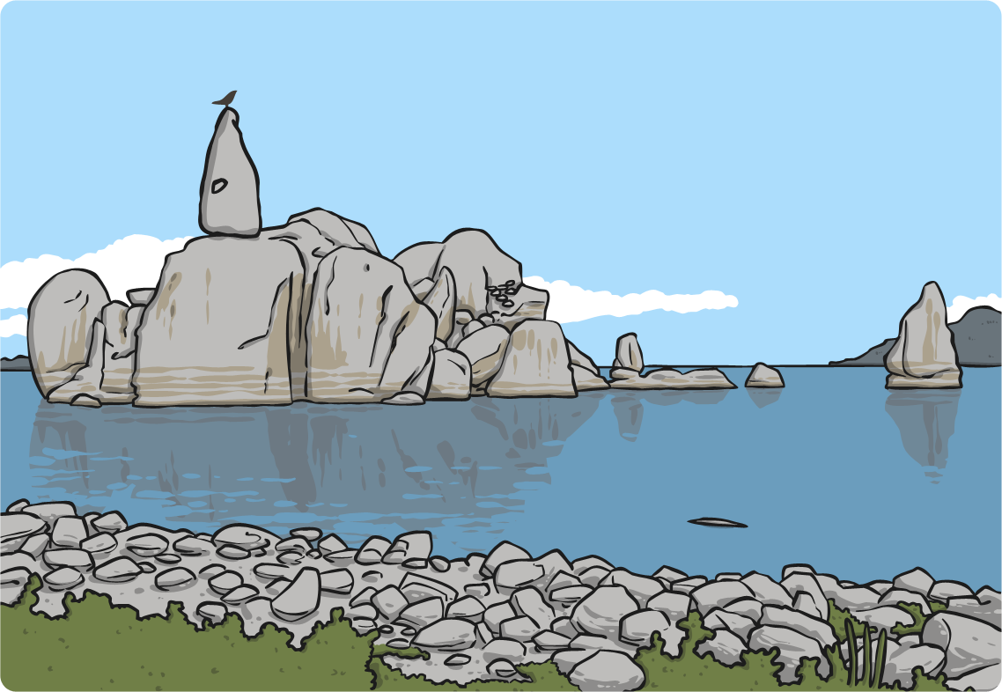
Kenya shares Lake Victoria, the world’s second largest fresh water lake, with Tanzania and Uganda.

Slide 17
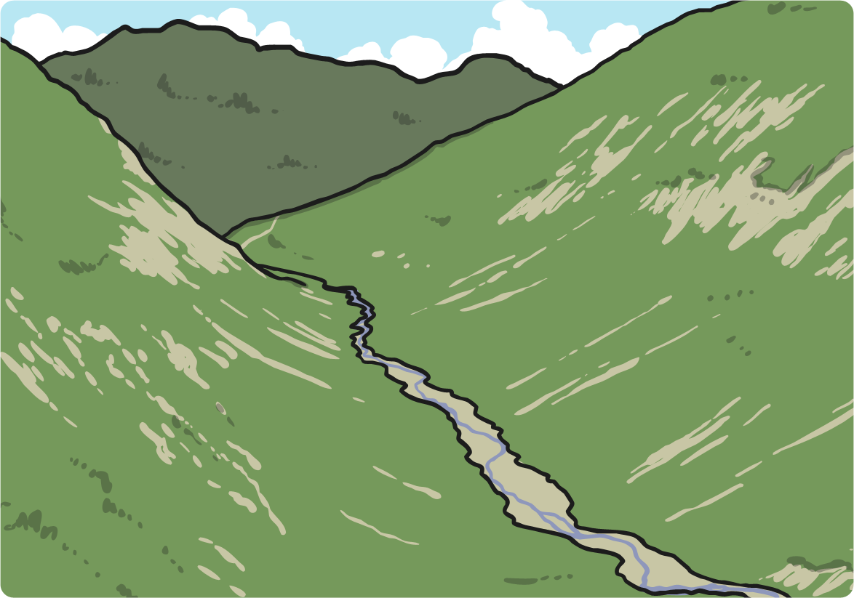
The Great Rift Valley, a 6400 km tear in the Earth’s crust can be found west of Nairobi. Within this valley are the green waters of famous Lake Turkana.

Slide 18
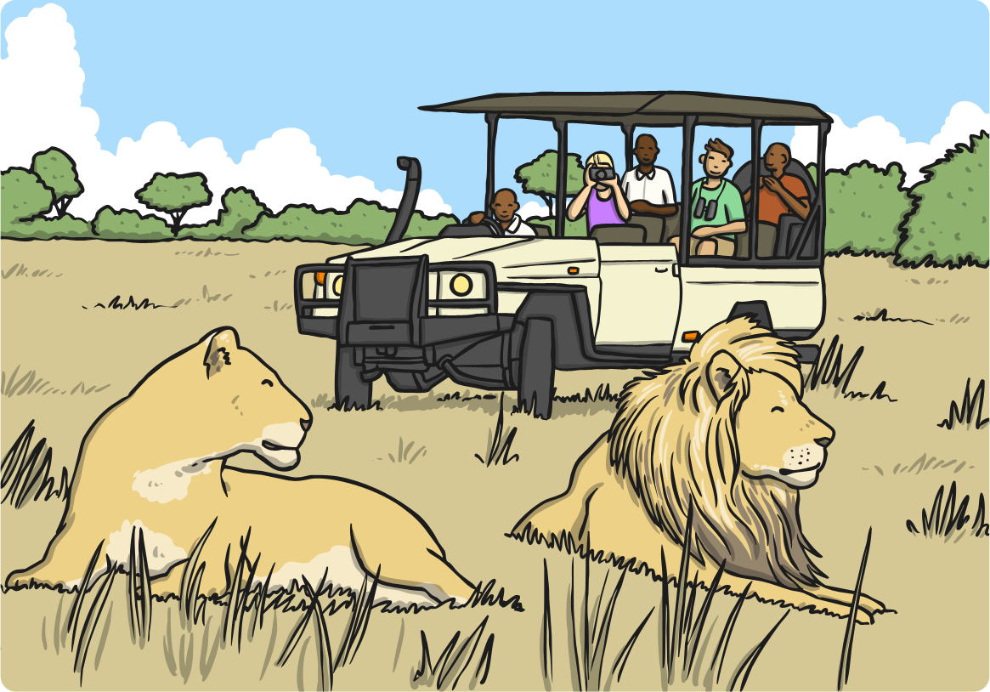
Millions of tourists visit Kenya each year to see the savannah, wildlife, nature reserves and to go on safari. Kenya has more than 50 animal reserves to protect its beautiful wildlife!

Slide 19
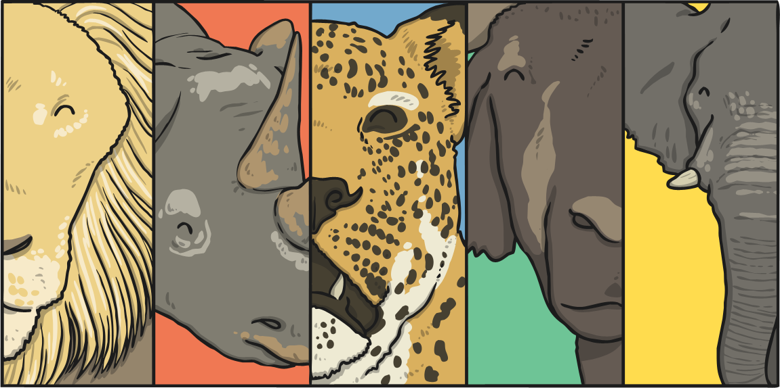
The Big Five animals of Africa can be found in Kenya (in the Maasai Mara National Reserve in particular): the lion, leopard, buffalo, rhinoceros, and elephant.

Slide 20
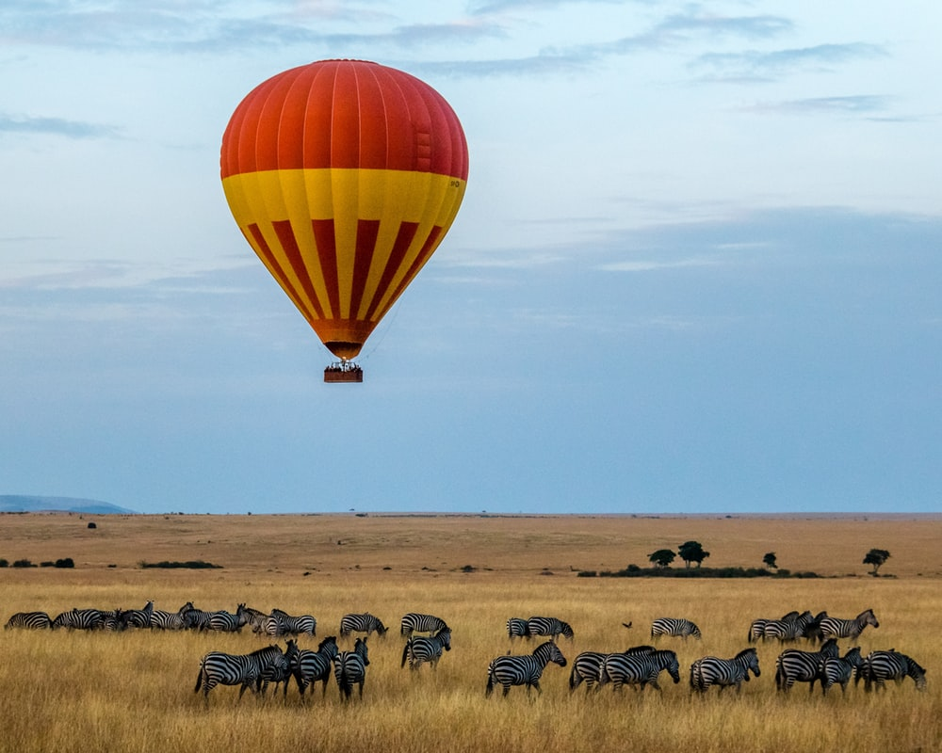
Tourists to Kenya can also swim with dolphins, feed orphaned elephants, take a balloon ride or sail in a dhow (sailboat) for a picnic lunch on the beach.

Slide 21
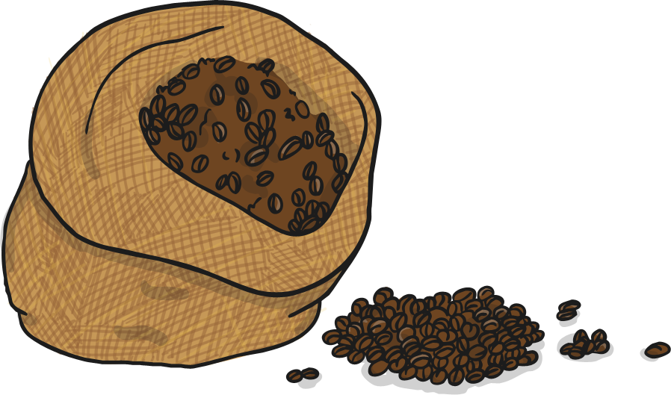
In rural Kenya, most people work in agriculture. Agriculture is important to Kenya’s economy, especially exporting tea, coffee and flowers.
In the cities, people may work in businesses, shops or factories.

Slide 22
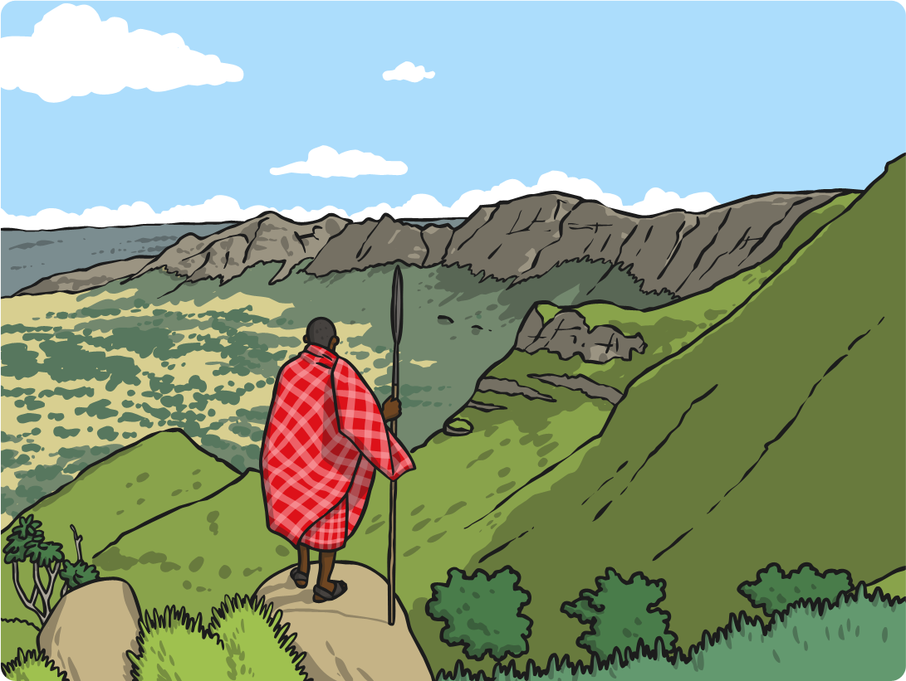
The Maasai tribe are a group of people who live close to the national parks and nature reserves in Kenya. They follow a traditional way of life, moving from place to place and looking after their cattle and families.

Slide 23
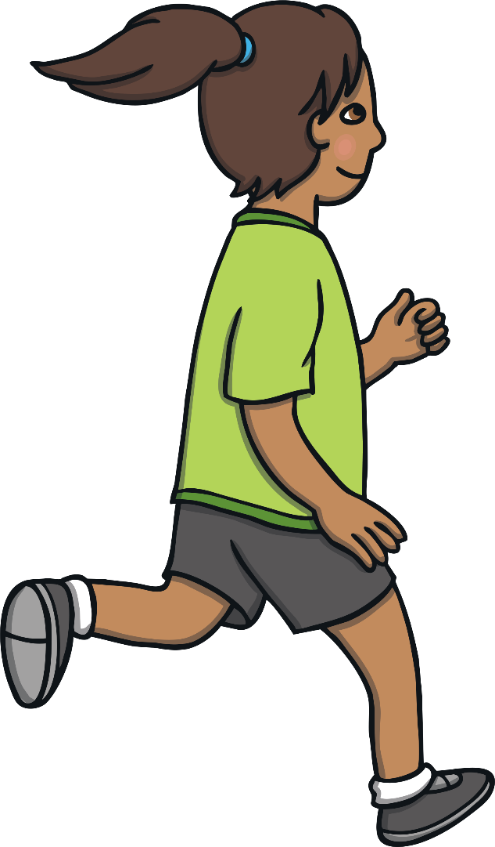
Sport is popular in Kenya.
Kenya is perhaps best known for its middle distance and long distance runners, with the country frequently producing Olympic champions.

Slide 24
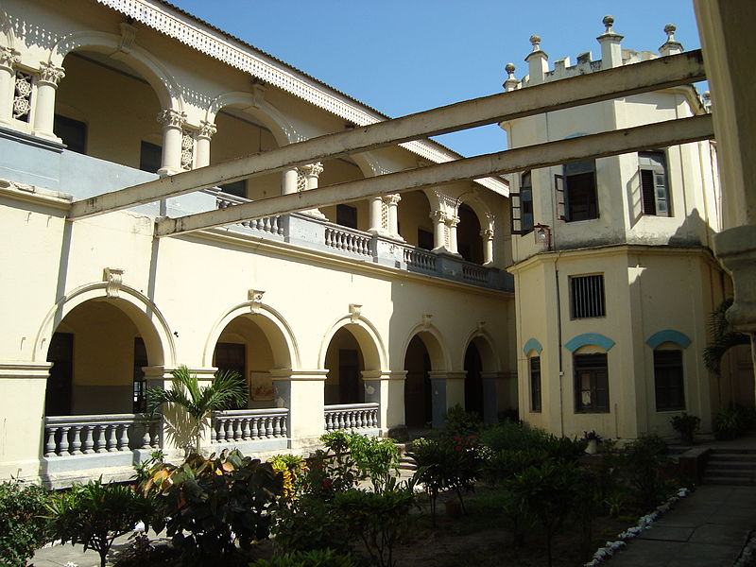
School is free for all children in Kenya.
In some rural areas, children (especially girls) may not attend school because they are expected to help out at home.

Slide 25
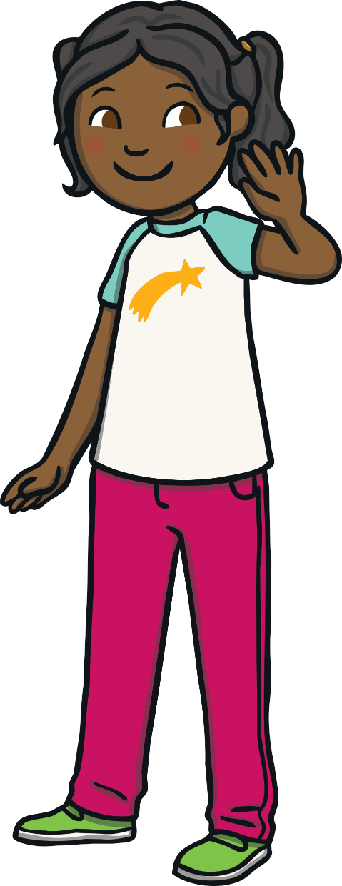

Kenya was a colony of the United Kingdom from 1920 until 1963. Since its independence, it has been a republic.

Slide 26
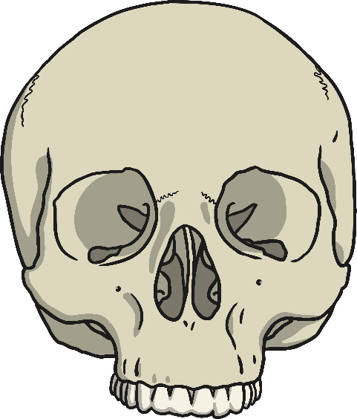
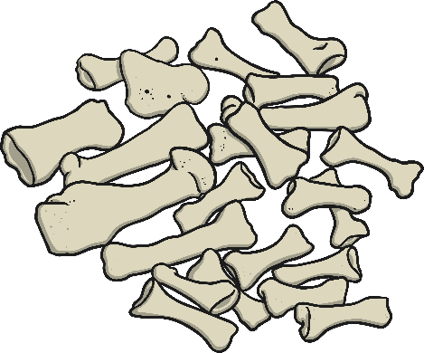
Scientists think Northern Kenya and Tanzania may have been the original birthplace of humans! The bones of one of the earliest human ancestors ever found were discovered in Kenya’s Turkana Basin.

