Slide 1


Porthcawl Primary Curriculum
2022/2023

Slide 2
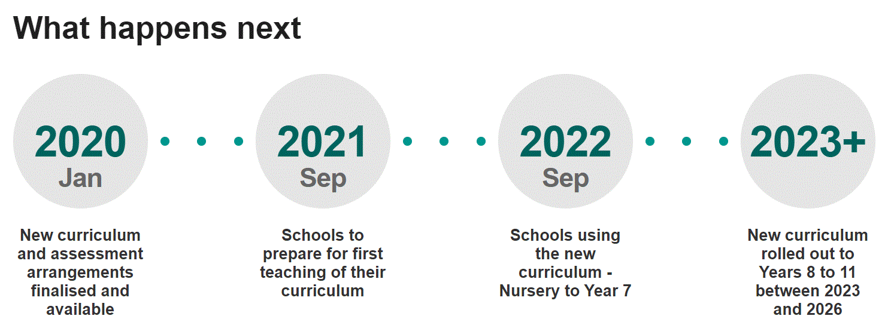
Curriculum for Wales
This year the Curriculum for Wales has been rolled out across Wales. This means at Porthcawl Primary we now have a unique and custom made curriculum designed and created by our staff. We have created a curriculum in which our pupils will develop a wide range of knowledge and skills through exciting and engaging experiences. We have also celebrated our location with many links to Porthcawl and Wales.

Slide 3
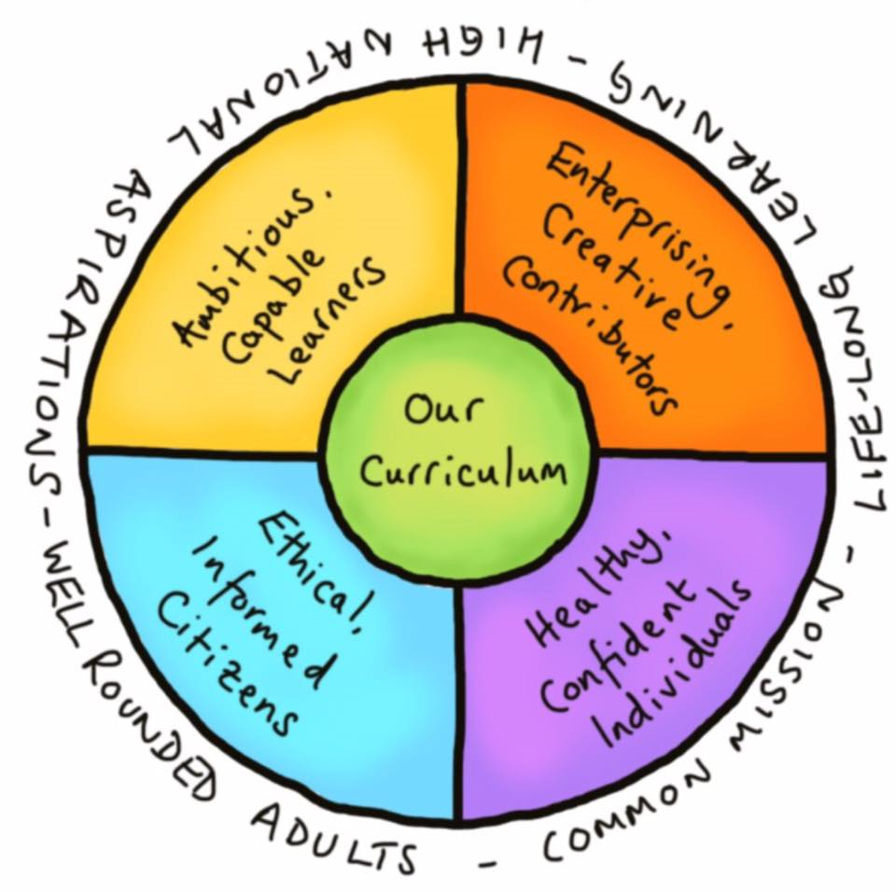
The four purposes are the shared vision and aspiration for every child and young person. In fulfilling these, we set high expectations for all and promote individual and national well-being

Slide 4


Slide 5
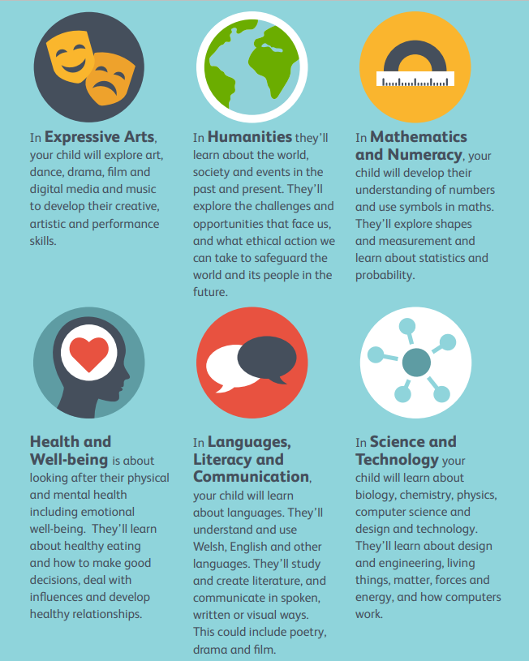

Slide 6

Notes:
26

Slide 7
Curriculum areas will stay the same (or similar)
English (Phonics, Spelling, Reciprocal Reading, Visual literacy, Letterjoin)
Maths (Big Maths, Abacus)
Welsh –although we now have to introduce a modern foreign language!
ICT
PE (Real P.E.)
Wellbeing (Jigsaw)

Slide 8
Curriculum areas that have been remapped
Humanities
Science and technology
Expressive Arts
History
Geography
R.V. E.
Biology
Physics
Chemistry
D.T.
Computation
Music
Art
Drama

Slide 9
We have worked with PCS so we know where they want our pupils to be when they leave us in year 6.
Geography
Map/Atlas work-Know the Continents, oceans and seas, mountain ranges- global scale.
The UK- Wales, England, Scotland, Ireland, seas, capital cities and where they are located on the map.
Finding places using an atlas. ( Pupils awareness of where places, countries are, is awful - including the sixth form.
Grid references, direction- using Wales and UK to apply to: latitude and longitude.
Basic graphs- bar and line graph.
Their local area
Landscapes of Wales- understanding key - coast, Mountains, rural, Urban characteristics.
Key words- densely, sparsely populated
Labelling pictures

Slide 10
History- year 7 starter knowledge
The battle of Hastings and the Norman Conquest.
The Black Death
Castles
Tudors & Stuarts
Industrial Revolution
The World Wars

Slide 11
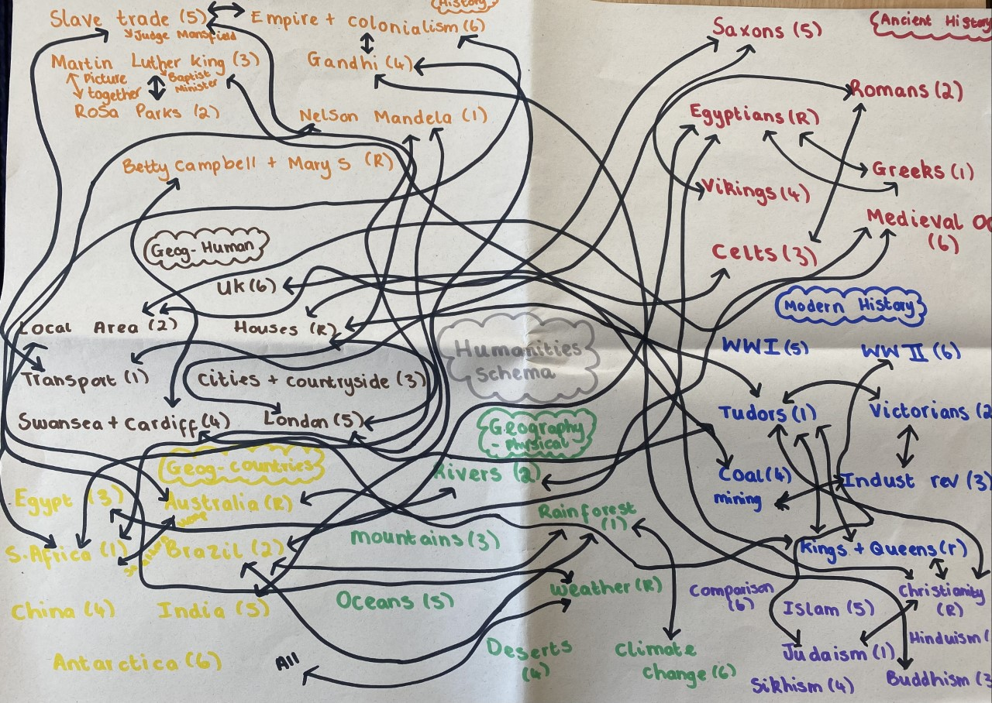
Humanities Schema-choosing concepts and strands. Links throughout curriculum to ensure progression and depth.

Slide 12

We have created a 3D curriculum that has clear links in each module but also across year groups. What pupils learn in Reception will be revisited and built on as pupils move through the school.

Slide 13
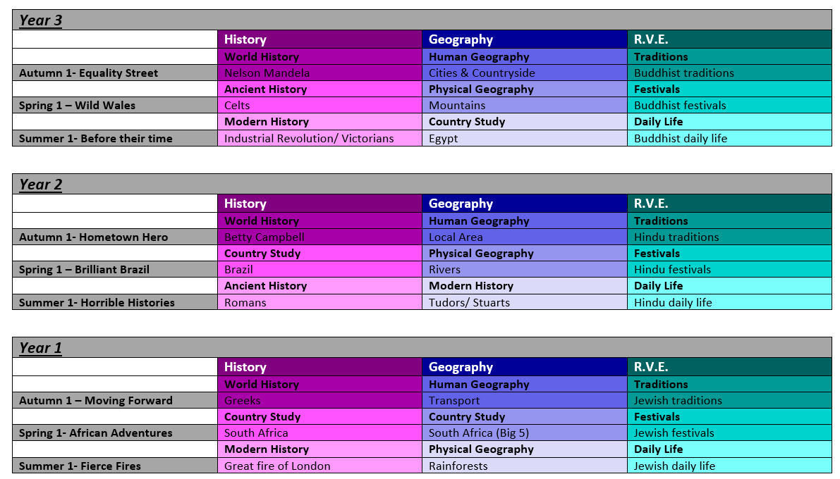
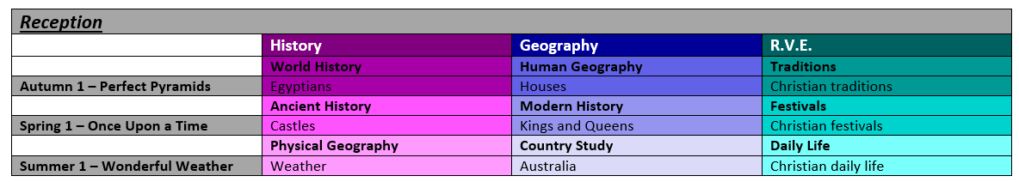
Half term 1- Humanities
Notes:
126

Slide 14
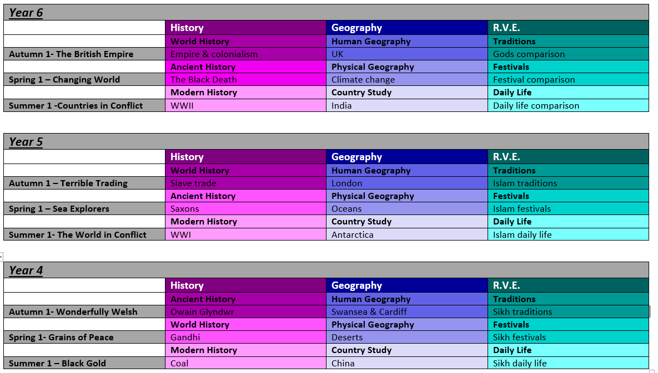
Half term 1

Slide 15
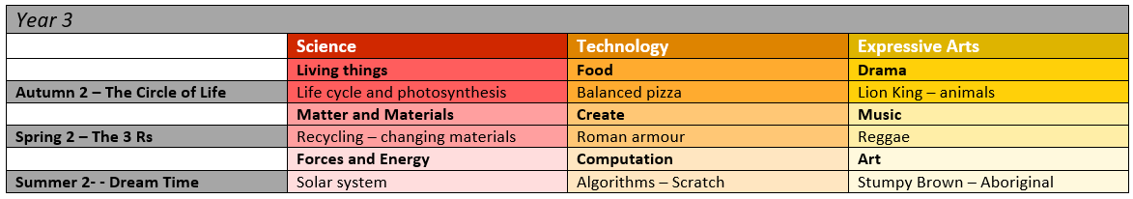
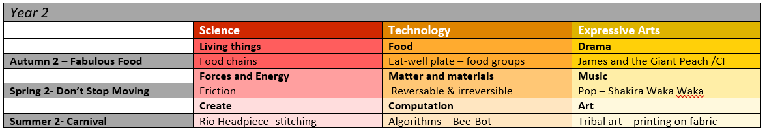
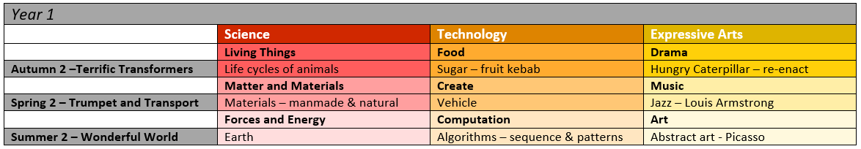
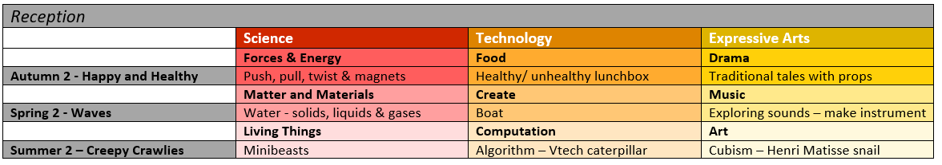
Half term 2- Expressive Arts and Science and Technology

Slide 16
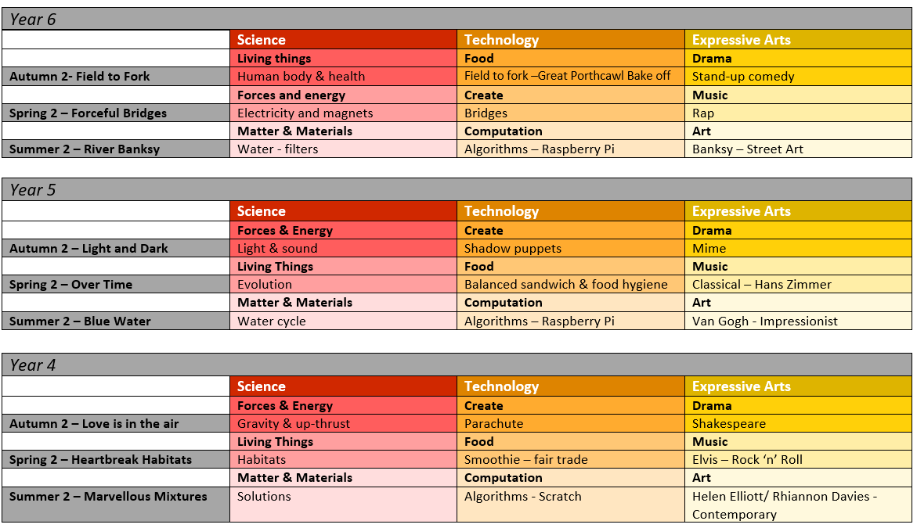
Half term 2

Slide 17
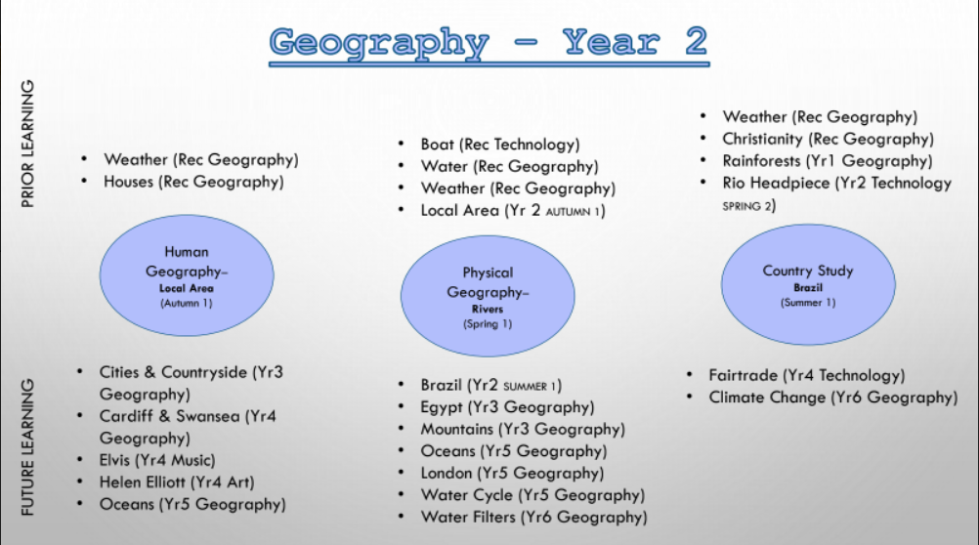

Slide 18
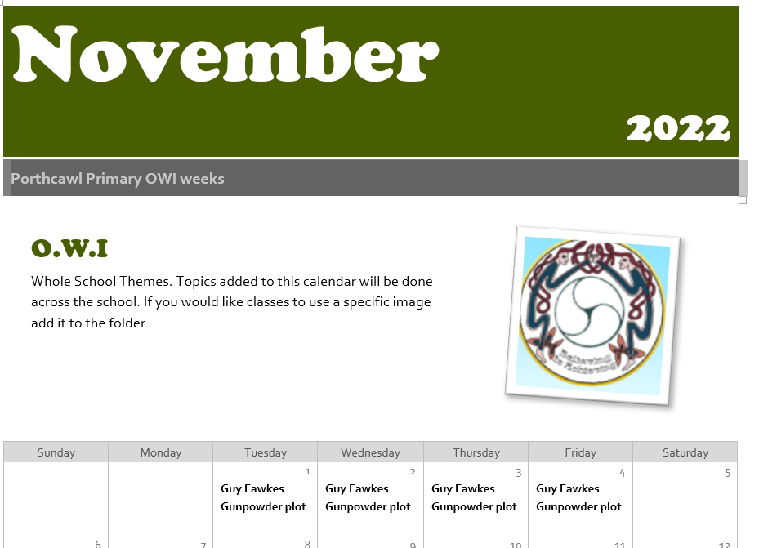
OWI themed weeks- Pupil voice
On Google classroom there is a calendar for the next academic year.
Staff can add days or weeks for a whole school OWI theme. These can be linked to Saint days, World celebration days, historical events or topical news events.
On blank weeks classes can continue to select their own OWI images and these could add to modules. For example when year 6 are doing Antarctica they could have a week of images linked to Captain Scott and the Terra Nova expedition. Images could also be linked to pupil questions in sessions.

Slide 19
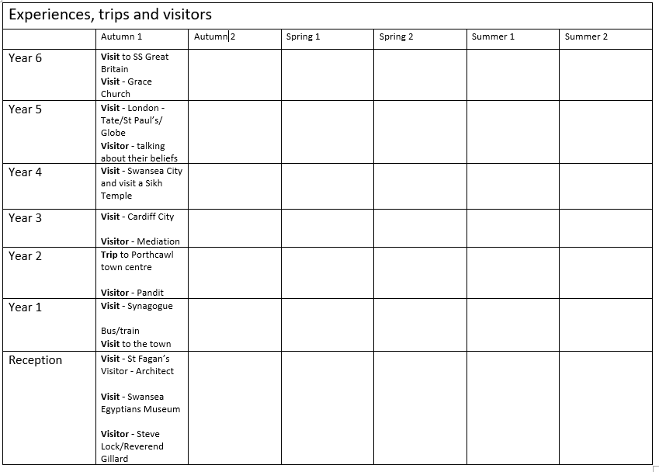
Exciting experiences are an important part of the new curriculum but many will take place in school.

Slide 20
Under constant review- improvements already being made.
Non negotiable skill box
Two week blocks instead of days?
Horizontal links
Principles of progression
Humanity contexts – Section 5 – designing your curriculum. Disciplinary contexts and concepts
Expressive Arts- Dance links in with music/drama. Film and digital media

Slide 21


Any Questions?

